Slide 1
CSE 316 Project Gesture Based Mini Piano
Supervised By
Mahjabin Nahar
Lecturer
Dept. of CSE
BUET
Presented By
Adrita Hossain Nakshi -1705019
Nahian Salsabil - 1705091
Rittik Basak Utsha - 1705105

Slide 2
Description
Our project is basically a mini piano using ATmega32 microcontroller. Our piano will be able to produce sounds of different frequencies. We intend to make the piano playing experience a bit interesting by making it gesture based. It will also be able to record and replay the tune played on the piano.

Slide 3
Motivation
Make something that is fun
Learn different functionalities of the microcontroller
Learn through practical experience
Make something unconventional
Future usage

Slide 4
Features
Play 12 different musical notes at a time
Play the keys by hovering fingers on them
Display played frequency and note
Change octave
Record played music and save it
Replay saved music

Slide 5
Component list
ATmega32 microcontroller
ATmega Burner
IR sensors
16x2 LCD display
Piezo buzzer
External Memory (SD card/ EEPROM)
LEDs
Push buttons
Breadboard
Jumper wires
Resistors, Capacitors

Slide 6
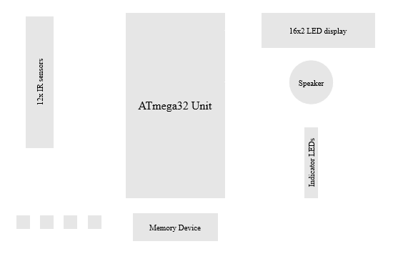
Block Diagram

Slide 7
THANK YOU

